Slide 1

SEGR 4141/EMGT 5141
Course instructor: Dr. Agnes Ozelkan
Experimental Analysis to Check Color Accuracy of iOS Photo Editor vs Android
Team 3
Mahima Korad Vibhuti Desai
Akshaya Reddy Joash Koshy

Slide 2

Overview
Recognition of the Problem Statement
Choice of the Factors, Levels, Ranges and Blocks
Selection of the response variable
Planning and Performing of the Experiment
Analysis of the experiment using Minitab
Results and Conclusion
Difficulties/Lessons Learned from this project
Future Scope
References

Slide 3
Recognition of the Problem Statement
Problem Statement:
Conducting an experimental design to find the color accuracy of the lipstick on IOS editor vs Samsung editor by comparing it to the reference color value.
Motivational ideas to obtain the problem statement:
While researching on this particular topic, we came up with the idea of how the color value of a specific color can be identified without using any expensive software, and that should be readily available in your devices. We have used lipsticks as our basis to find the shades, however, this can be used with the color shade of any other object/material as well.

Slide 4
Choice of Factors and Levels
I. Type of Lipstick
Matte
Creamy
II. Brand
Lakme
Maybelline
III. Price
Under $15
Above $15

Slide 5
Blocks, Controllable and Uncontrollable Factors
Blocks
Two team members performed the experiment. So there are 2 Blocks: Akshaya and Vibhuti.
Controllable Factors
Brand, Price, Experimental Blocks, lighting conditions where the pictures were taken and Replications
Uncontrollable Factors
Shade of natural lips, Complexion, Camera settings, Image Resolution, Software Algorithms

Slide 6
Selection of the Response Variables
We have two response variables for our experiment:
Response Variable 1:
IOS Photo Editor
Response Variable 2:
Samsung Photo Editor
We choose these response variables as it helps us understand the clear accuracy of the color value identified from iOS vs Android while comparing it to the original RGB color codes of the lipstick collected from the brand website.
The units are measured in RGB (Red, Green, Blue) to check the accuracy where it ranges from 0 to 255 (0 being black and 255 being white).

Slide 7
Planning of the Experiment
Vibhuti and Akshaya will be applying the same type of lipstick, same brand, and same price. Mahima and Joash will be helping us in taking the pictures after we apply the lipstick. There will be 2 replications to perform this experiment.
After taking the pictures, we will check the color intensity (RGB) of the lipstick shade value using the IOS editor and Samsung editor.
The RGB values are 3 values but we’re subtracting the RGB values with respect to the actual RGB value on the color code of the lipstick that we are considering from the brand website and then adding all the three values to input the response variable as a single variable.

Slide 8
Performing the Experiment
A factorial design is created based on randomization in order to input the response variables.
We performed two factorial analysis by adding response variables for Android and IOS. After the difference is calculated, we input it as a response variables and perform the statistical analysis and check the accuracy.
After the statistical analysis is performed, we will analyze if the whole process is under statistical control by checking the P-value in ANOVA charts. We will also check the normality plots and check if there are sufficient interactions between all the factors.

Slide 9
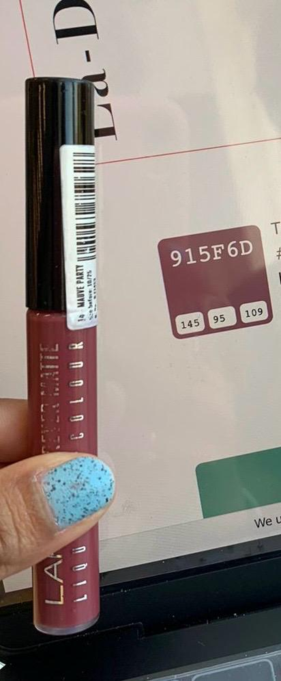
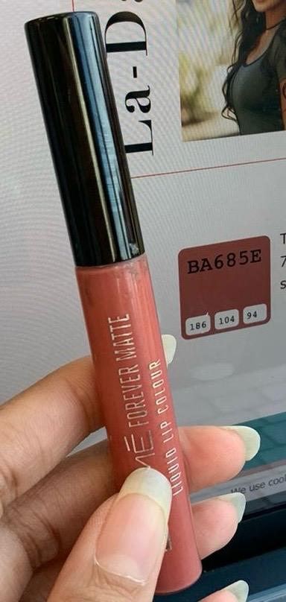
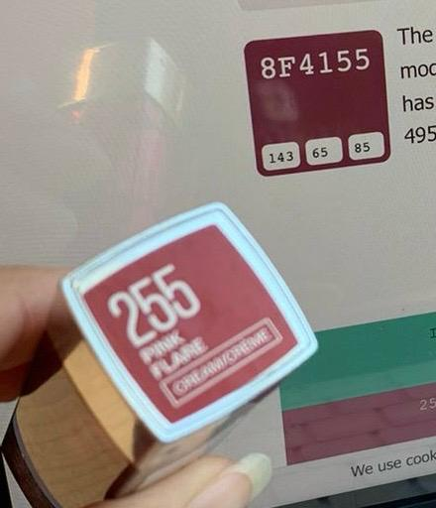
Performing the Experiment
Above shown are the original color codes of the lipstick shades and these RGB values are used to calculate the response variables

Slide 10
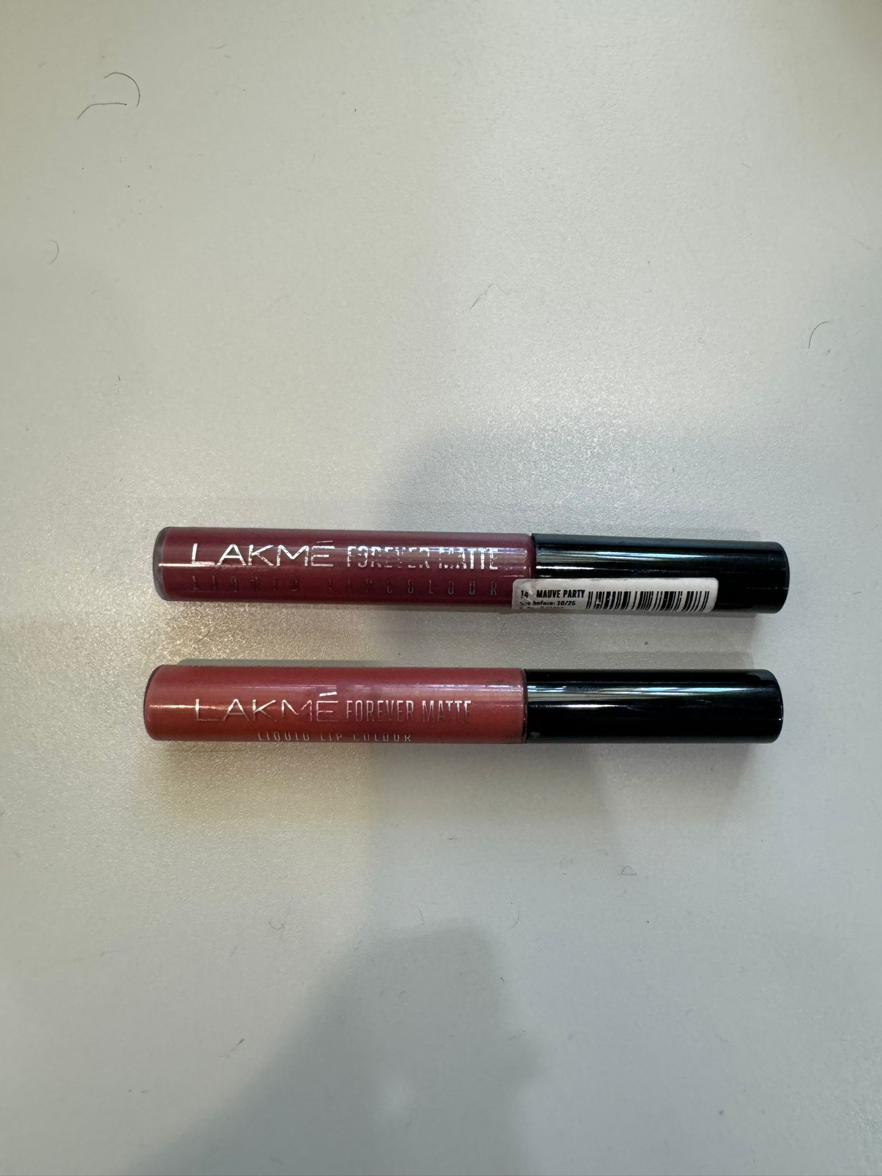
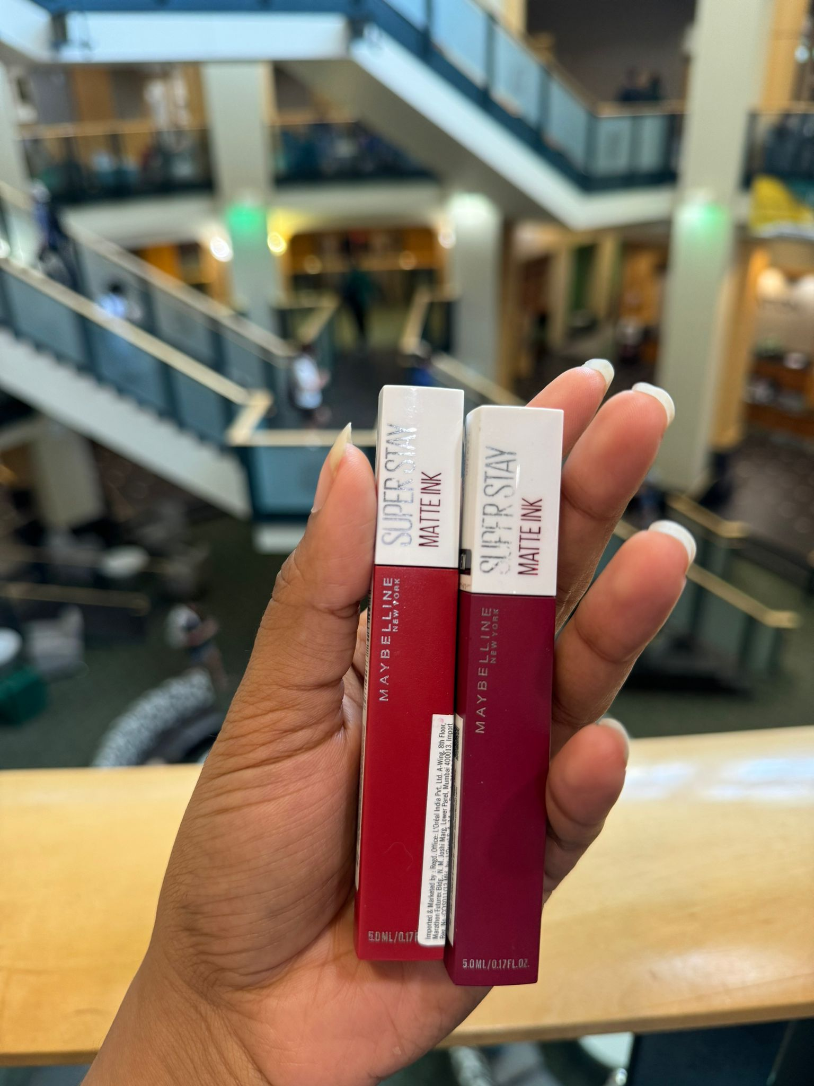
Performing the Experiment
These are the lipsticks used for the experiment

Slide 11
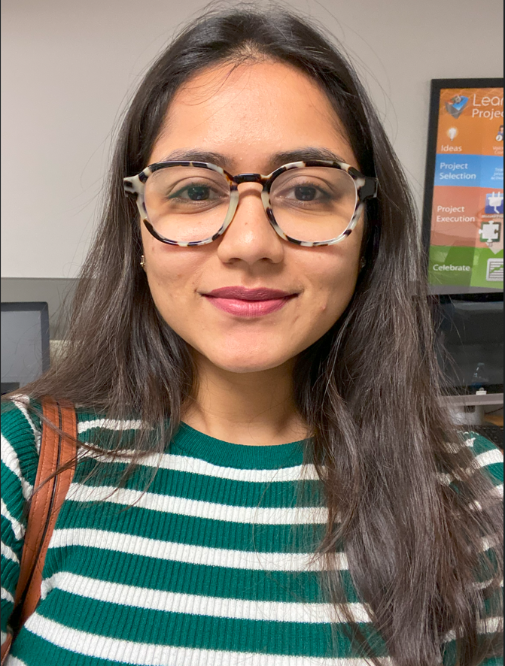
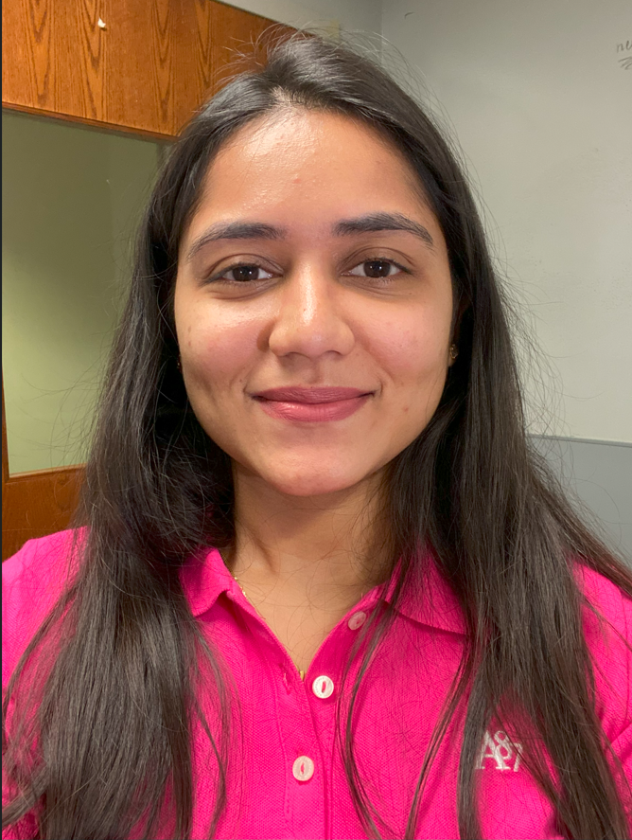
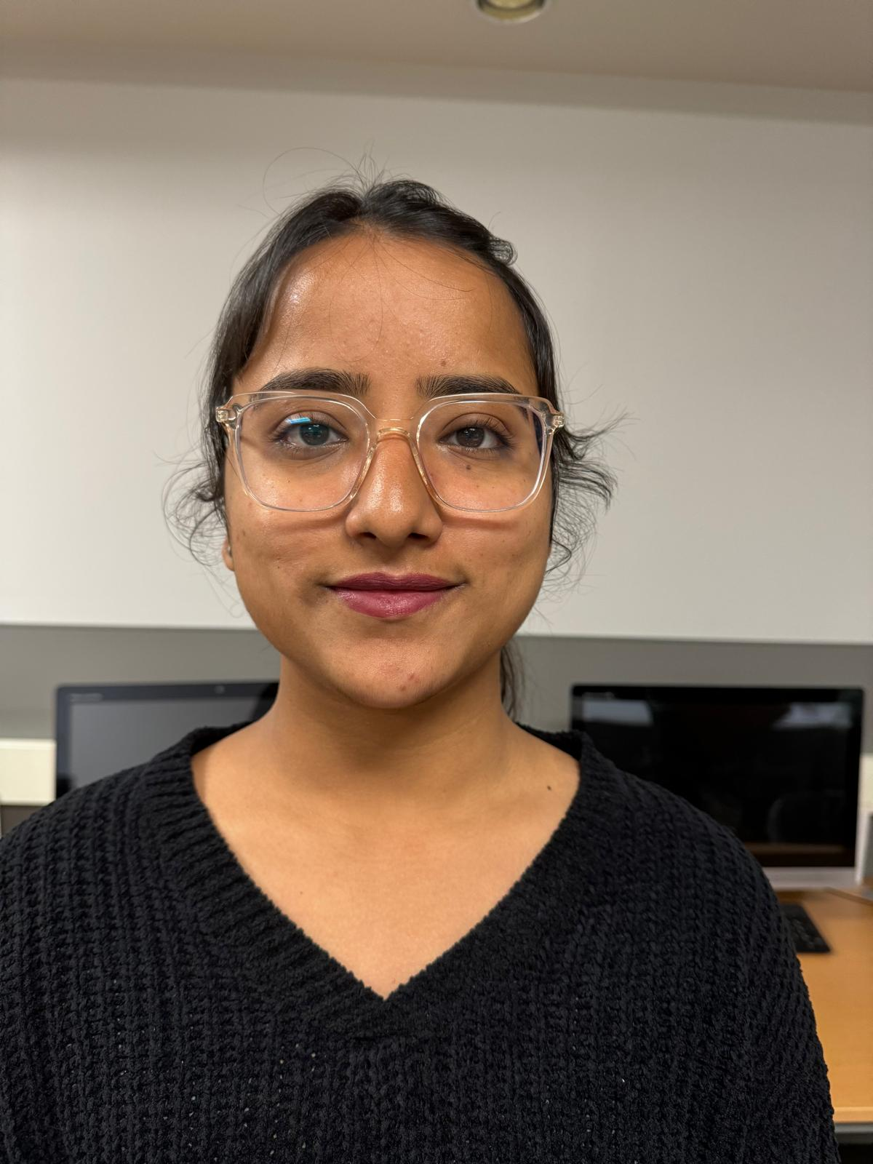
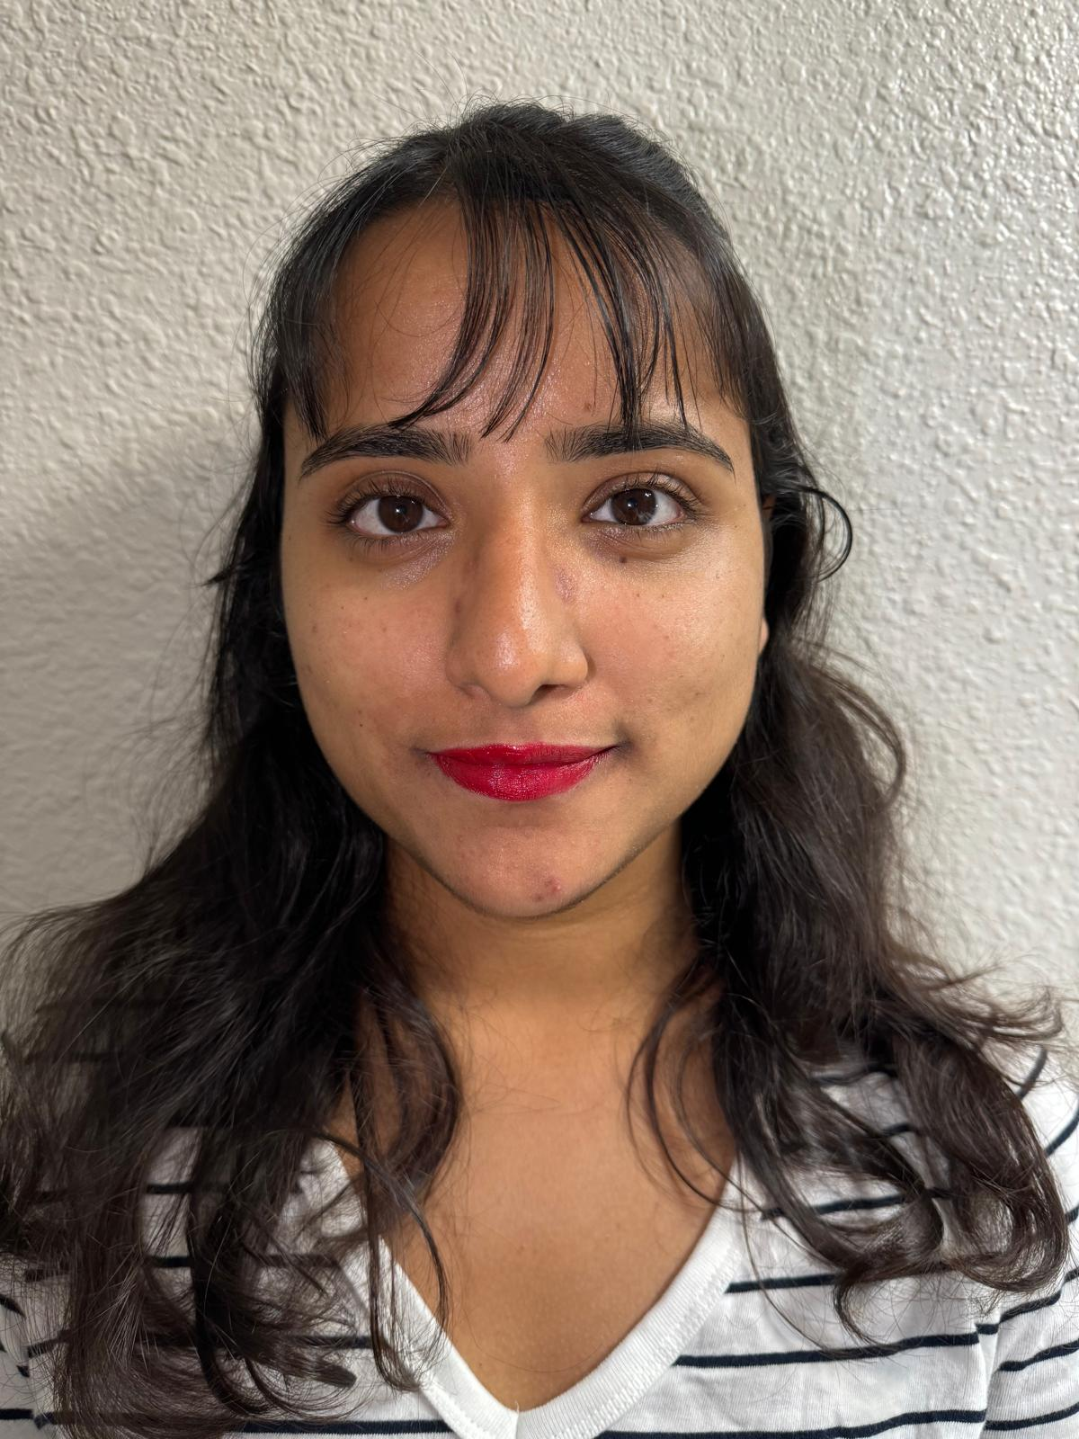
Performing the Experiment
Some of the pictures after applying the lipstick on Vibhuti and Akshaya

Slide 12
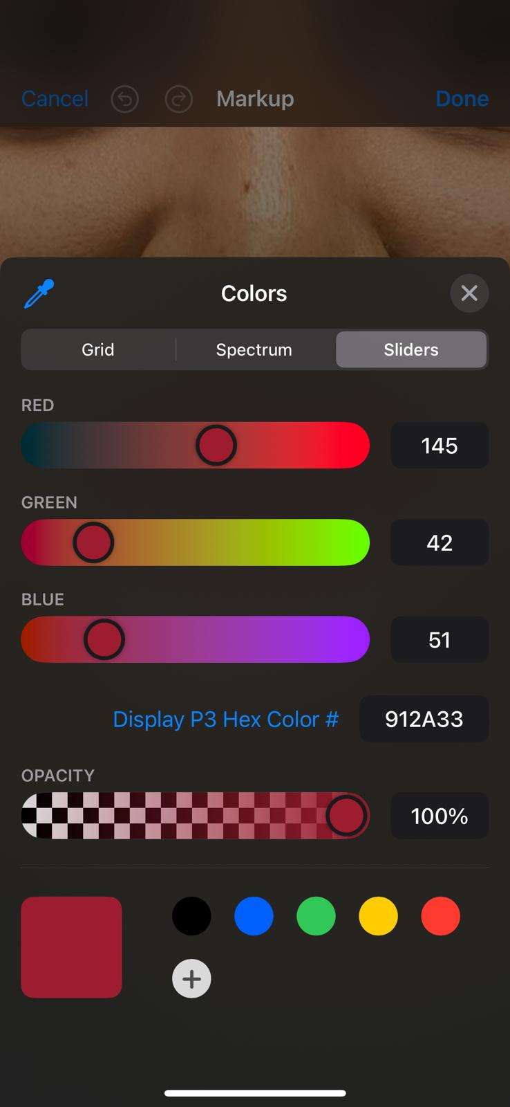
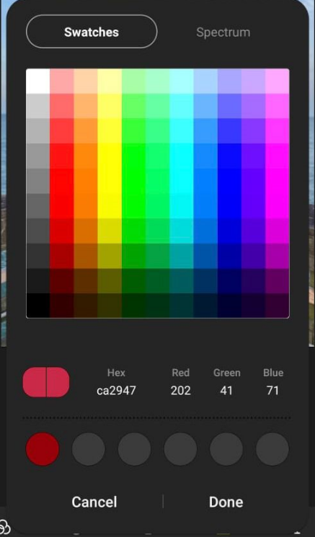
Performing the Experiment
IOS Editor
Samsung Editor

Slide 13
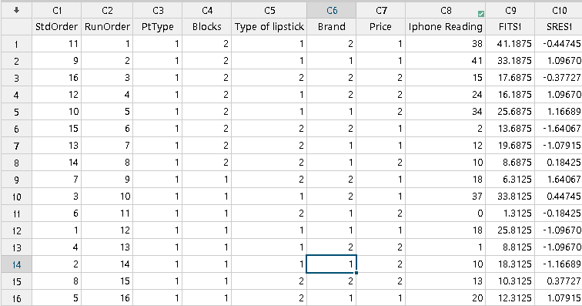
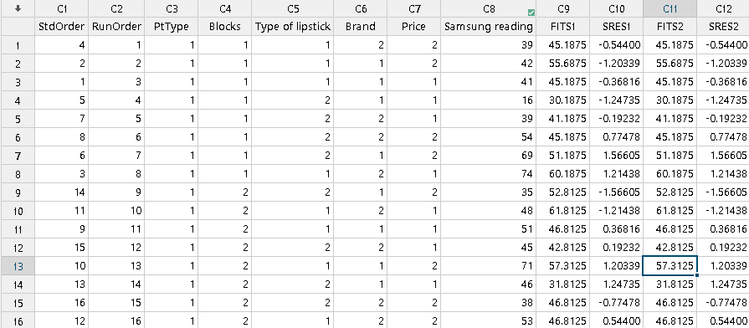
Randomizations and Replication

Slide 14
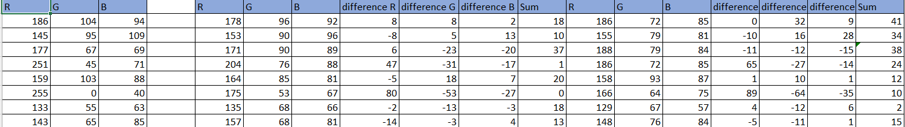
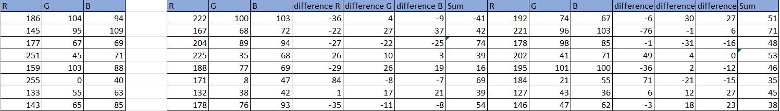
Calculation to input the response variable
This is the difference of RGB values calculated with the iOS phone editor vs the original color codes.
This is the difference of RGB values calculated with the Samsung phone editor vs the original color codes.

Slide 15
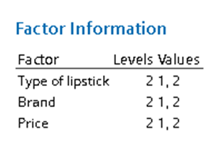
Analysis
General Factorial Regression: IOS Reading versus Blocks, Type of lipstick, Brand, Price
IOS READING
SAMSUNG READING

Slide 16
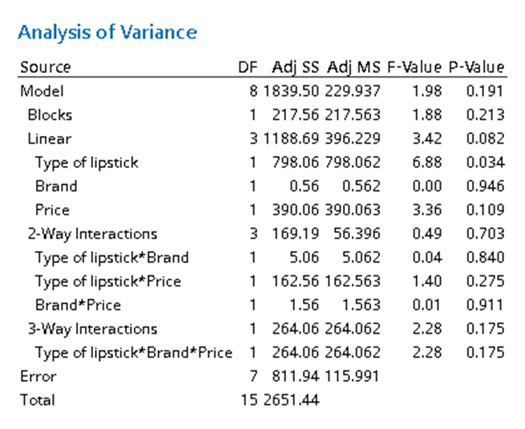
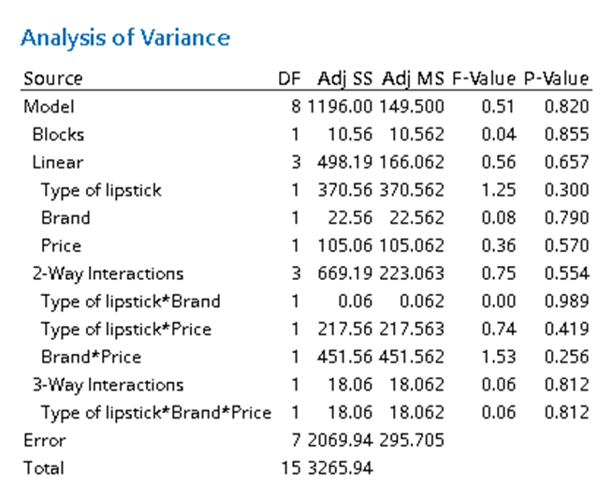
Analysis
IOS READING
SAMSUNG READING

Slide 17
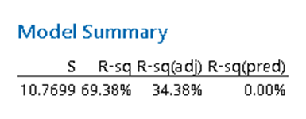

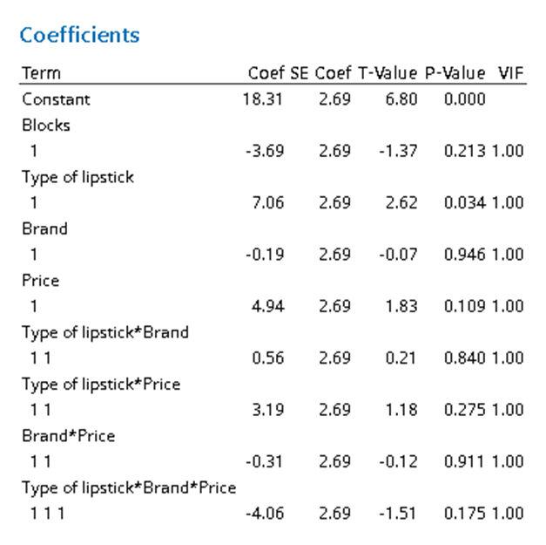
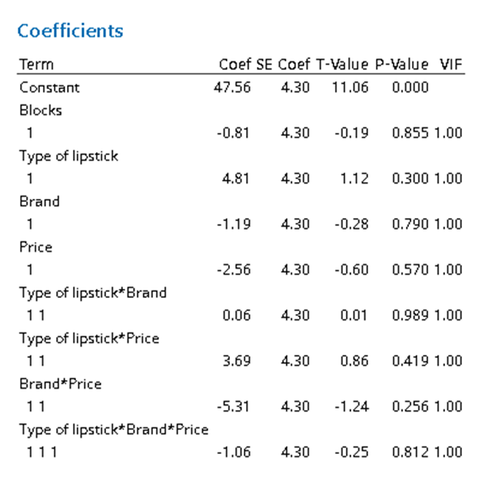
Analysis
IOS READING
SAMSUNG READING

Slide 18
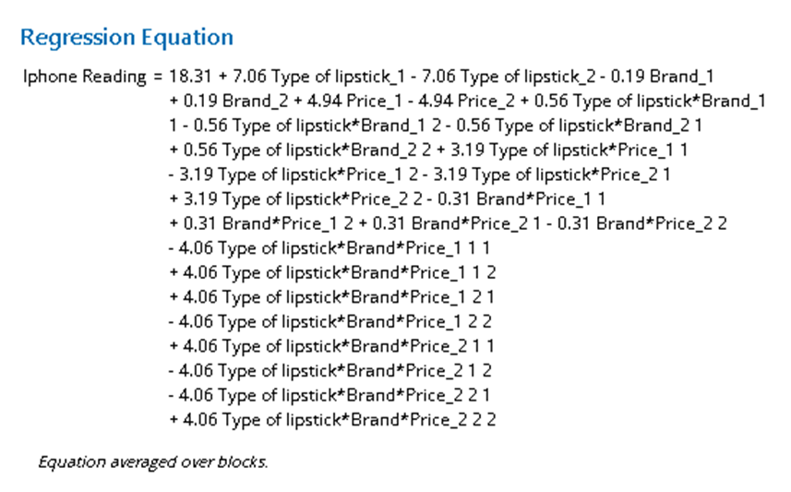
Analysis
IOS READING

Slide 19
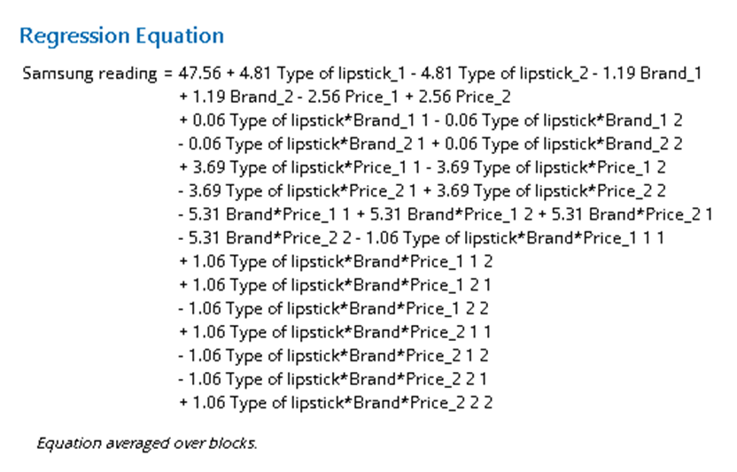
Analysis
SAMSUNG READING

Slide 20
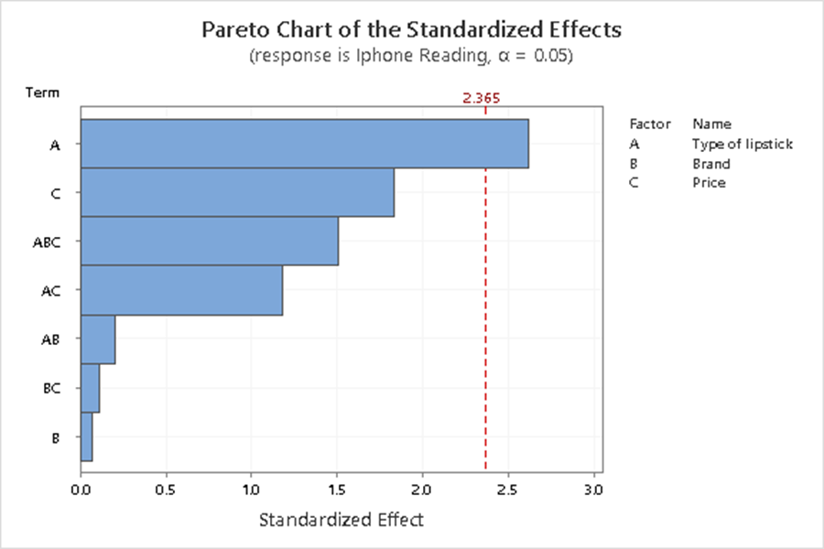
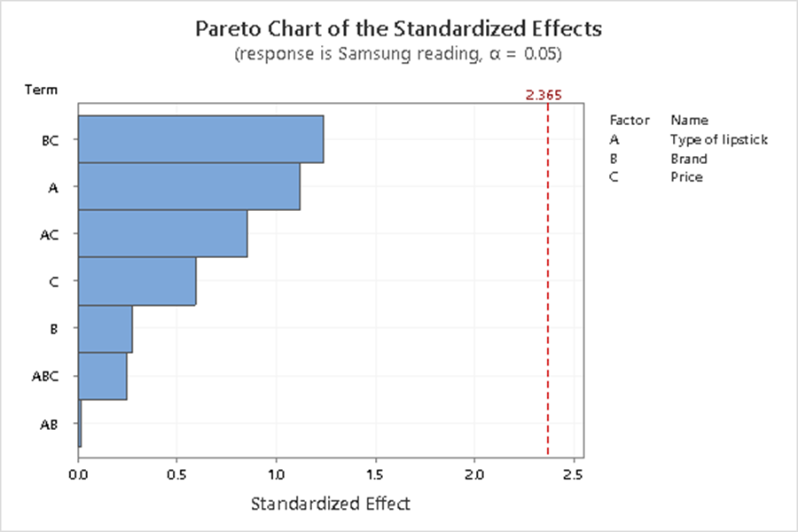
Analysis
IOS READING
SAMSUNG READING

Slide 21
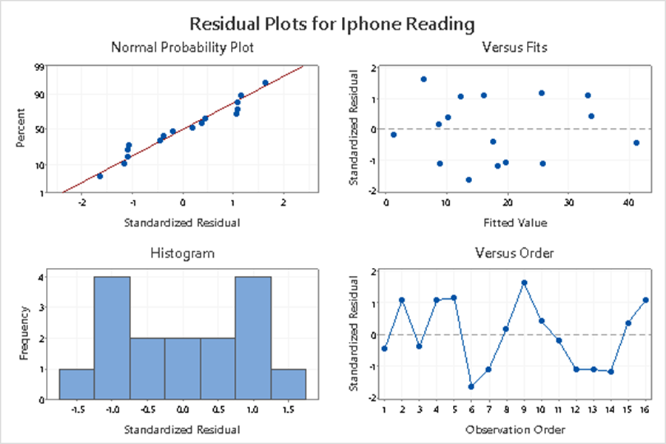
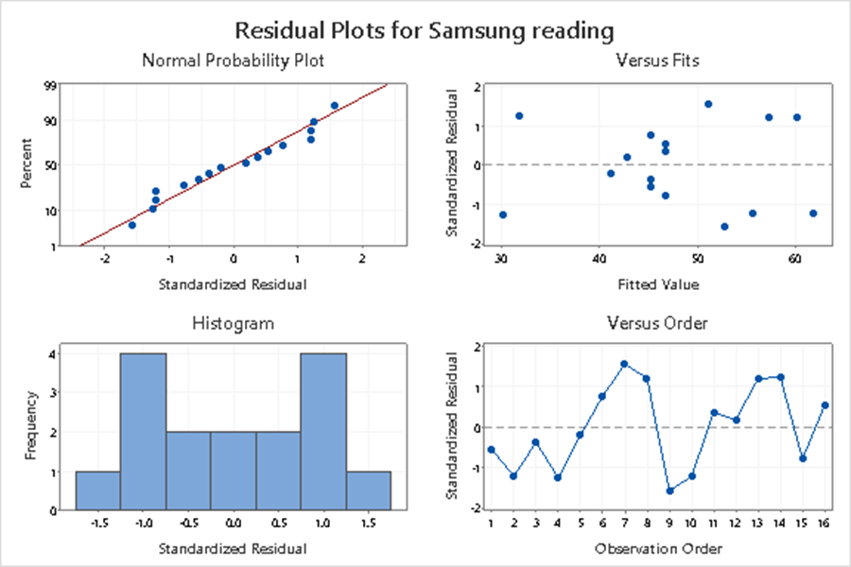
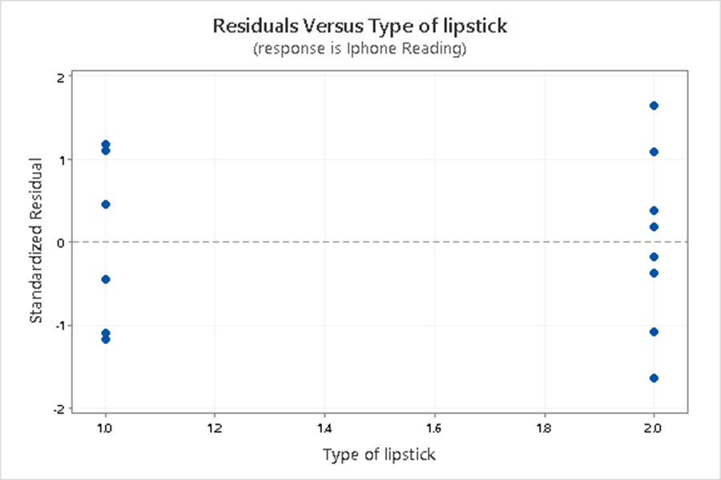
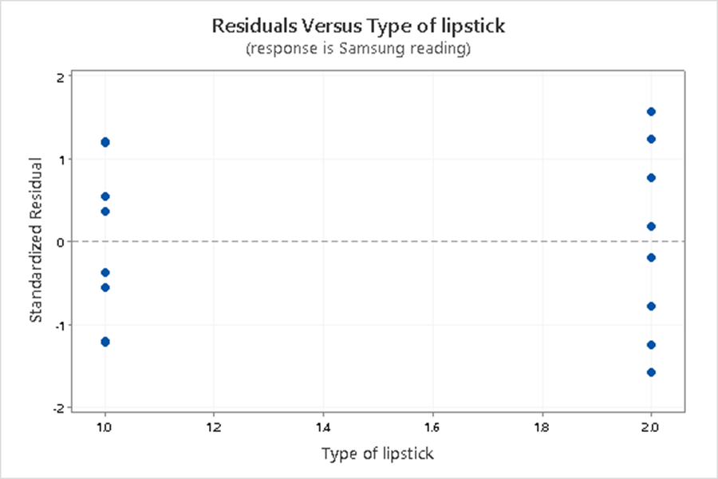
Analysis

Slide 22
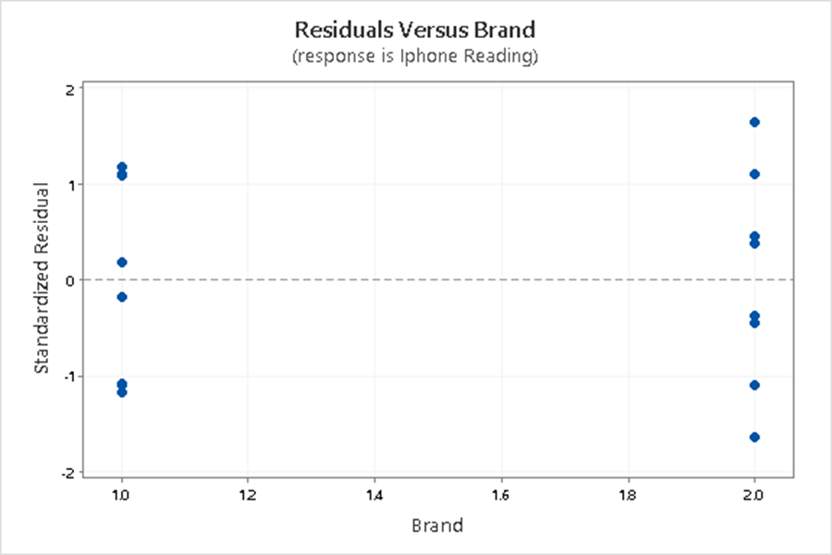
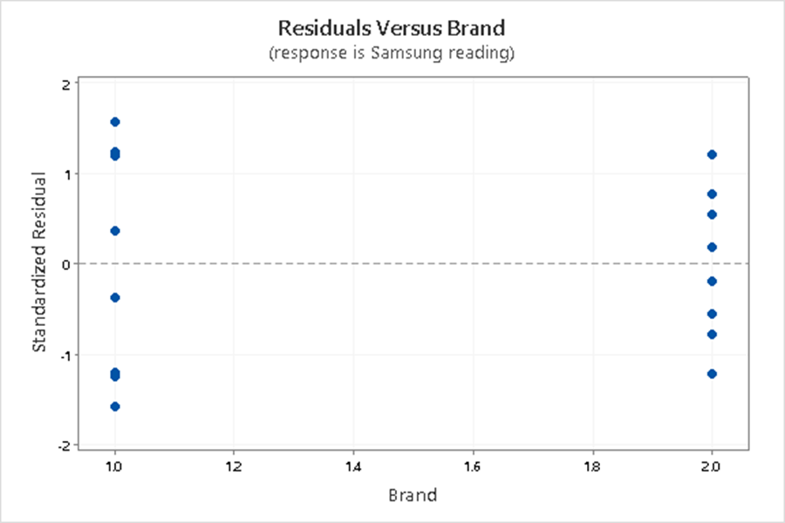
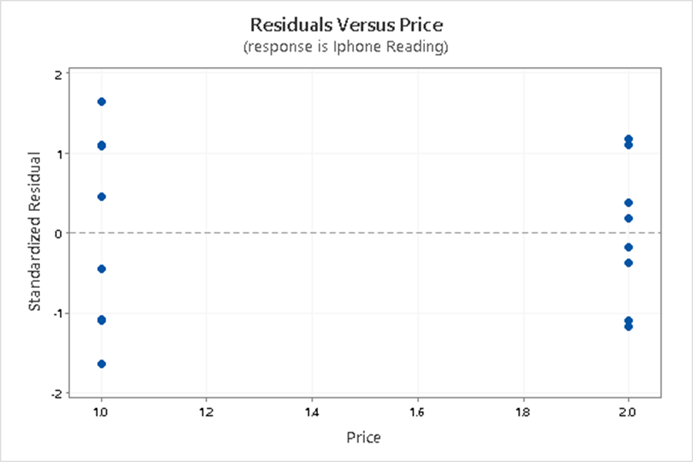
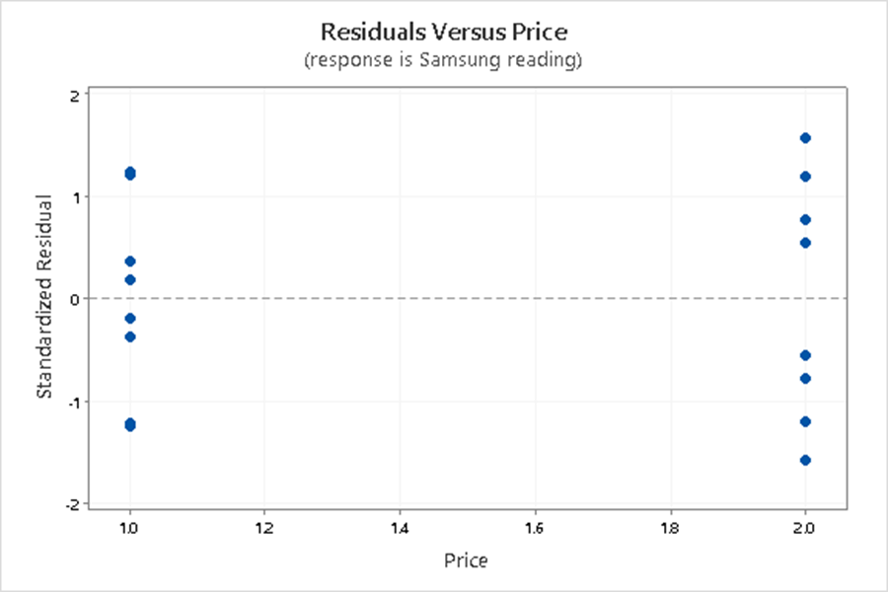
Analysis

Slide 23
Results and Conclusions
From our statistical analysis, we can prove that the IOS editor is more significant than the samsung editor as the p values of the samsung editor is greater than 0.05.
We can also conclude that we saw that the normality is satisfied in the IOS editor analysis by comparing it to the thick pencil rule. In the samsung editor analysis, we saw that the normality wasn’t satisfied.
From the Pareto charts, the IOS editor shows that the Type of lipstick has a significant effect but in the samsung editor there is no factor which shows a huge significant effect.
Based on the results, the IOS editor can be used to check the accuracy and find the exact color code of the color of lipstick . The accuracy of our experiment is 95%

Slide 24
Difficulties and lessons learned from this project
Difficulties:
To find the exact shade of the lipsticks was a major challenging task, which we figured out later from the brand website page.
Initially, it was IOS vs Photopea editor app, which we later changed to IOS vs android as that is a better way to make use of the results, we achieved though this experiment.
Lessons Learned:
How to divide each tasks within the team to perform the experiment better.
Understanding the in-depth analysis of Minitab while performing our own experiment, since we have done everything from scratch from collecting the data to performing the experiment. Since we made our own data set.

Slide 25
Future Scope
Expand to other devices and editors: After establishing the methodology for comparing color accuracy between the IOS and Samsung editors, we would like to extend this experimental analysis to various other smartphones. This would provide a broader understanding of how different devices and software handle color representation.
Add more lipstick brands and shades: While the current experiment focuses on a specific lipstick brand and shade, in the future we would like to broaden the scope by including a variety of lipstick brands and shades and multiple other factors. This would allow us to assess whether the accuracy of color representation varies depending on the specific color and formulation of the lipstick.
Cross-verify other factors influencing color accuracy: Beyond the device and editor, there can be other factors that influence color accuracy in photographs, such as lighting conditions, camera settings, and image resolution. Investigating these factors could provide additional insights into how to improve color accuracy in digital photographs.
Real-world applications: We would also like to extend this research to many real world scenarios like digital marketing campaigns and advertising. After understanding the factors that affect color accuracy in digital photographs could help businesses and content creators create more appealing and accurate images.

Slide 26
References
Aaker, D., and Biel, A. L. (1993). Brand Equity and Advertising. London: Psychology Press, 101–109.
Badhe, S. K. (1976). New approximation of the normal distribution function. Communications in Statistics - Simulation and Computation, 5(4), 173–176. doi:10.1080/03610917608812017
Bartz, A. E. (1999). Basic statistical concepts (4th ed). Upper Saddle River, NJ: Merrill
Bergson, A. (1968). Certification of and remark on algorithm 304: Normal curve integral. Communications of the ACM, 11(4), 271. doi:10.1145/362991.363048
Android vs iOS. (n.d.). Diffen. https://www.diffen.com/difference/Android_vs_iOS

Slide 27
Questions?

